Slide 1
transsexuality an insight into sex reassignment surgery

Slide 2
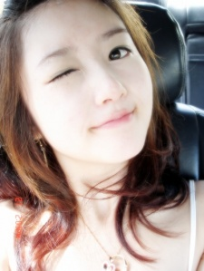
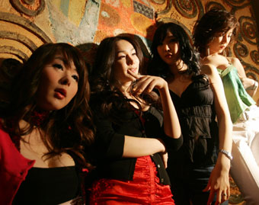
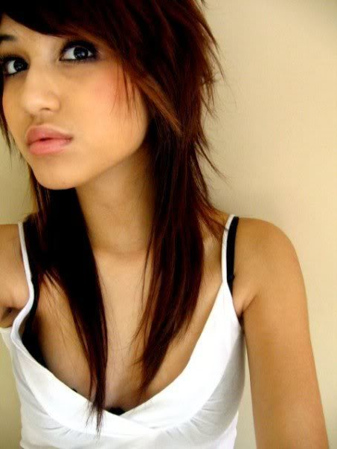
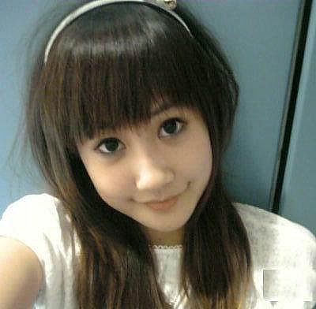
Spot the Transsexuals!

Slide 3
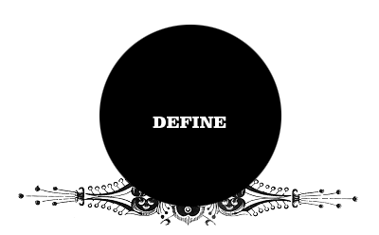
Transsexuality
a condition which occurs when an individual identifies himself or herself with a different physical sex to the one which they were born
Desire to be a member of the opposite sex
Unhappiness with the given sexual identity
Notes:
Both female to male and male to female transitions are possible but for the purpose of this presentation, we will only concentrate on the more prevalent transition; male to female.

Slide 4
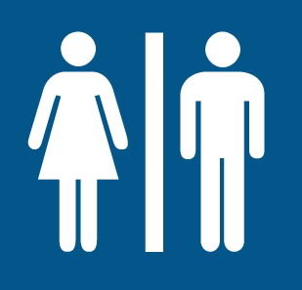
Gender Terms Resolved!
Transsexuals
experience variance between birth sex and psychological gender, and seek medical sex reassignment surgery (SRS)
Different types of transsexuals
1. Post-op
have undergone sexual reassignment surgery and are on hormones
2. Pre-op
plan to undergo SRS and are on hormones
3. Non-op
Do not plan to have surgery and are on hormones
Notes:
We recognize that people are often confused by the different gender terms. Resolve confusion.
Hormones taken to suppress original sex characteristics
The similarity between all is that they live lifestyles of self perceived gender.

Slide 5
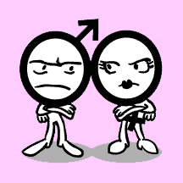
Gender Terms Resolved! (cont’d)
Transgenders
identify strongly with the "other" sex
adopt a life-style and appearance consistent with self-perceived gender.
genital sex reassignment surgery is usually not desired
Cross dressers
cultivate the appearance of the other sex on a recreational basis
Transvestites
use the cross-dressing as a type of fetish (sexual arousal)
Notes:
Transgenders
identify strongly with the "other" sex and often adopt a life-style and appearance that is consistent with their psychological gender self-perception.
This may or may not be supported by the use of hormonal medications, but genital sex reassignment surgery is usually not desired.
Cross dressers
cultivate the appearance of the other sex on a part-time or recreational basis, such as at clubs and social events
Transvestites
use the cross-dressing as a type of fetish (sexual arousal)
do not see themselves as the other gender or other sex.

Slide 6
SEX REASSIGNMENT SURGERY
(SRS)

Slide 7
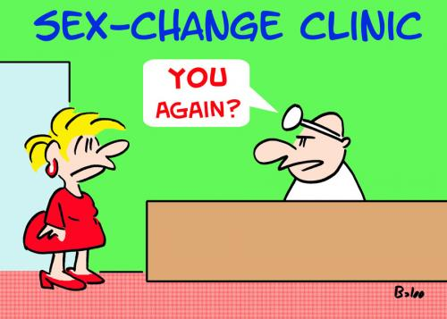
SEX REASSIGNMENT SURGERY
Surgical procedures whereby a person's functions of their current sexual characteristics as well as their physical appearance which will be altered to resemble that of the other sex.

Slide 8
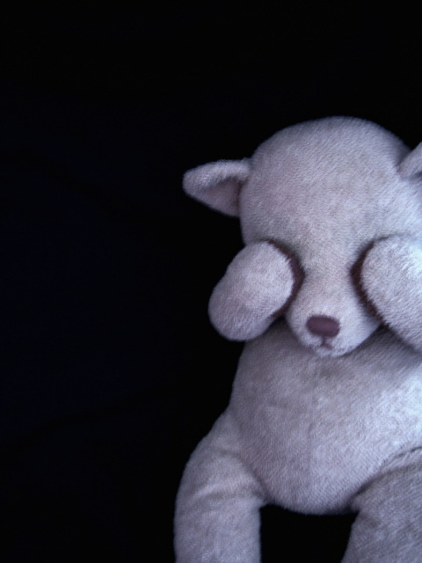
The following drawings Might be Offensive by some. Viewer discretion is advised.

Slide 9
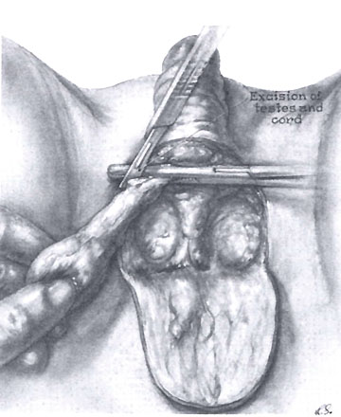
Right spermatic cord is clamped and litigated

Slide 10
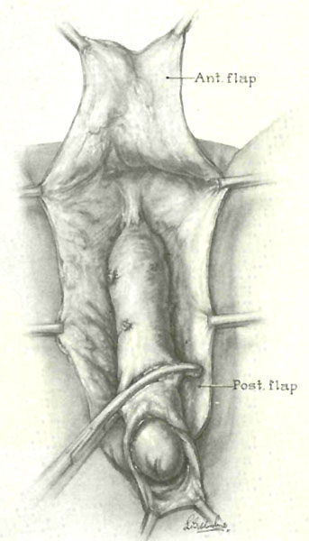
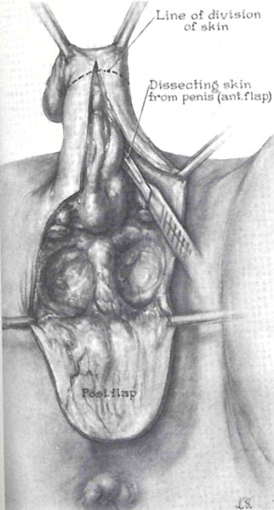

Slide 11
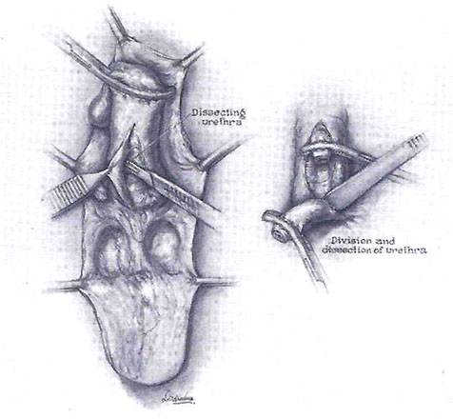
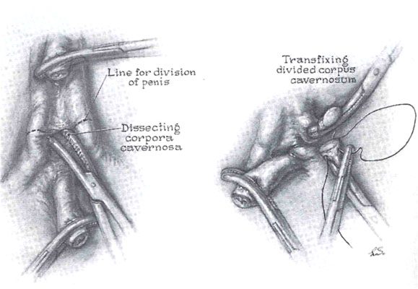
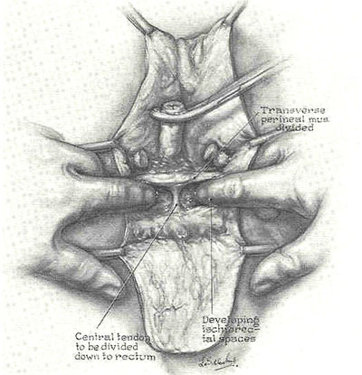

Slide 12
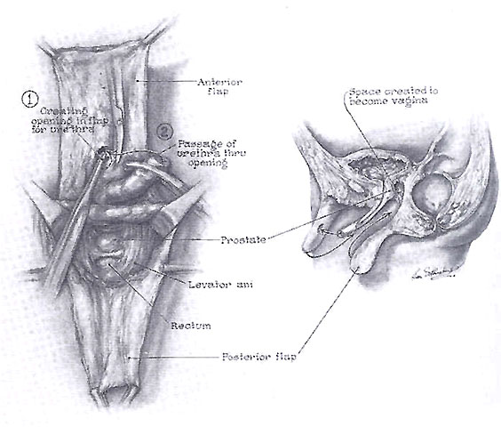
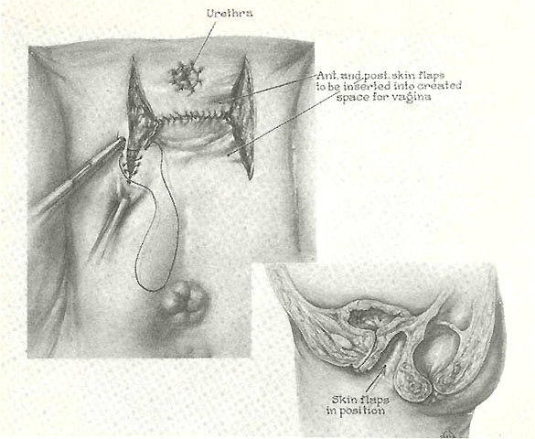
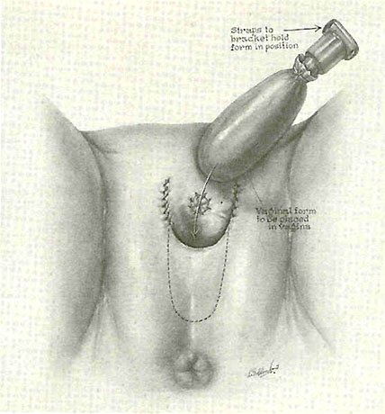

Slide 13
Additional procedures for complete transformation
Hormones
Facial feminization surgery
Breast implants
Voice feminization surgery
Tracheal shaves
Buttock augmentation
Notes:
Hormones
induce breast growth, decrease in body hair, redistribution of body fat, decreased fertility and testicular size and less frequent and firm erections.
2) Facial feminization surgery
feminizing cosmetic surgeries or procedures that modify bone or cartilage structures, typically in the jaw, brow, forehead, nose and cheek areas to make them look feminine
Breast implants
enlarge breasts
Voice feminization surgery
voice surgery alter pitch and tone – make it feminine
Tracheal shaves
remove cartilage at trachea, reduce appearance of the Adam’s apple
Buttock augmentation
enlarge buttocks as females have larger butts than men usually

Slide 14
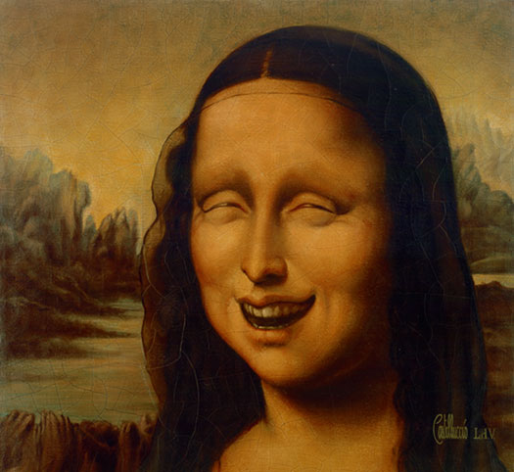
Who is he then?!
After a long night of making love, this guy rolls over, looks and notices a framed picture of another man on the nightstand by the bed. Naturally, the guy begins to worry.
"Is this your husband?" he inquires nervously.
"No, silly." she replies, snuggling up to him.
"Your boyfriend then?" he asks.
"No, not at all," she whispers, nibbling away at his ear.
"Is it your dad or your brother?" he asks, hoping to be reassured.
"No, no, no!!!" she says.
"Well who is he then?" demands the bewildered guy.
Calmly the girl replies, "That's me before the surgery."

Slide 15
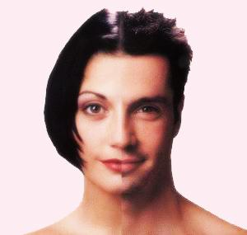
Sex vs gender dilemma Difference between terms
Sex
Gender
Determined by physical anatomy, biological description.
Biological and physiological characteristics that define men and women
Determined by social, cultural affiliation, learned behaviours.
Characteristics that a society or culture defines as masculine or feminine.
Notes:
In a nutshell, sex is what you are born as.
Gender is your true sexual orientation.

Slide 16
Sex vs gender dilemma
Case of self vs society issue
- please themselves by going for operation because sexual orientation is such
- face the risk of society discrimination
Society is made up of huge percentage of heterosexuals
The moment the see an oddity, they discriminate
Our culture does not have the right perception of sex and gender.
Misconception gives rise to unfair treatment to transsexuals
If we treat them as males, we defy the concept of gender. Yet, if we treat them as females, we defy the concept of sex.
Notes:
society in general has the misconception that sex and gender are the same.
- they do not fully understand the difference between the terms.
- they think that man behave in a feminine way because their lifestyle is such
- do not think that there may be a possibility of medical problem
Heterosexuals – straight people, so when they see someone who is not like them, they discriminate
If we treat them as males, we defy the concept of gender. Yet, if we treat them as females, we defy the concept of sex.

Slide 17
Medical dilemma
Gender identity disorder (GID)
Description
Strong cross-gender identification
Not all GID are transsexuals
Children with GID may become depressed, anxious or withdrawn
Why say yes to SRS?
Notes:
- Definition: used to describe a male or female that feels a strong identification with the opposite sex and experiences considerable distress because of their actual sex.
affect anyone. Children and adults alike.
usually caused by prenatal hormonal imbalance or sometimes problems in family interactions or family dynamics. This is a kind of mental disorder.
these people believe they are or should be opposite sex.
however, only those who are determined to undergo SRS are considered transsexuals. They often attempt to pass of socially as the opposite sex.
Children with GID refuse to dress and act in sex-stereotypical ways. They experience significant interference in functioning because of their cross-gender identification.

Slide 18
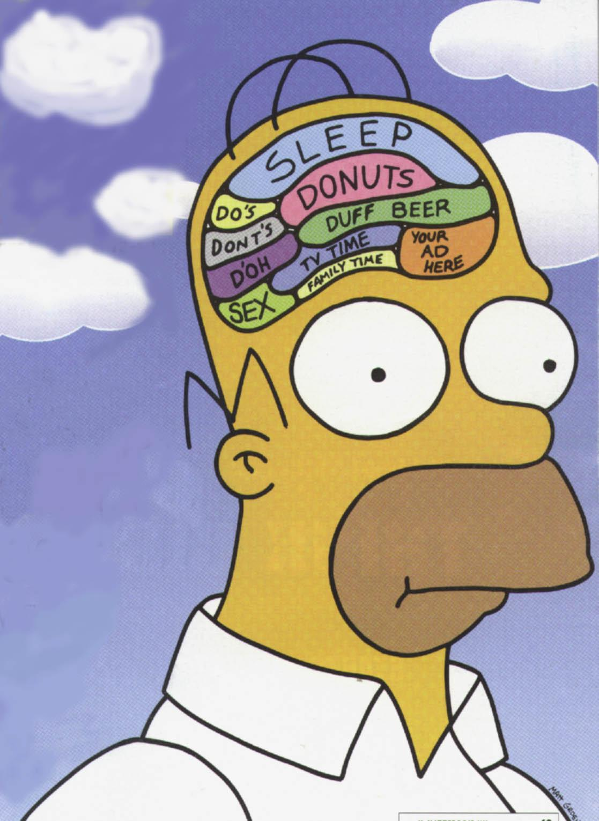
Medical dilemma why say yes to srs?
Congenital brain development issues
Definition
Congenital trait is something that is present at birth
Effects of hormones during fetal development
Cause
Due to a synthetic hormone administered to mothers
Between 1938 and 1971
Description
Estrogenic effect competent of altering fetal environment
Sex differentiation on the central nervous
system
Notes:
- Synthetic hormone called diethylstilbestrol (DES).
To prevent miscarriage.
DES only affect male children and will cause them to more likely become transsexual women than otherwise-male children not exposed to DES during that period.
Estrogen is a hormone relating to females.
Results in them wanting to be a female.

Slide 19
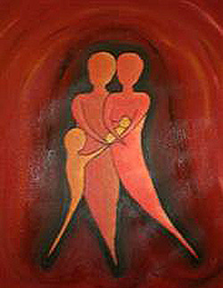
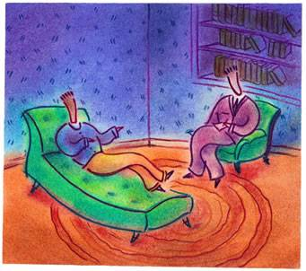
Medical dilemma why say no to srs?
Transsexuality is not a mental disorder or emotional problem
Can be resolved by psychotherapy
A result of extreme closeness to a family member of the opposite gender
Will grow out of it in time
Notes:
Their cross-gender identity should be changed, thereby eliminating the discrepancy between gender identity and body characteristics.
Dress them the right way and do the necessary things and they will change with time.

Slide 20
Medical dilemma why say no to srs?
Some transsexuals feel that it is not a mental disorder
Excerpt from blog of Julia Serano, a transsexual
‘While I am totally against the conceptualization of GID as a “mental disorder,” I think that there are ways in which our needs to physically transition and access appropriate medical procedures can be met without simultaneously undermining/marginalizing us as a community.’

Slide 21
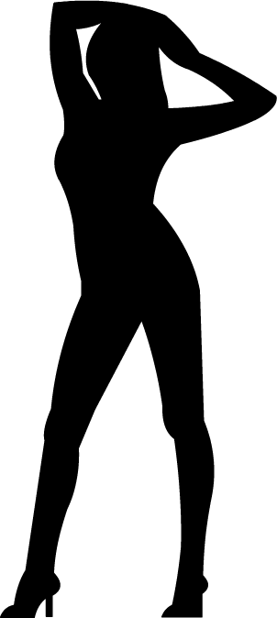
Social dilemma why say yes to srs?
Transgendered bill regarding hate crimes against the transgendered signed into law on 28 October 2009 in the United States.
SRS treatment often paid by insurance companies.
Alterations to birth certificate are possible.
Scientific interest in phenomenon increasing.
Social events to appreciate transsexuals.
Notes:
"Laws embody the values of our nation, and through the enactment of this hate crimes law, our country has — once and for all — sent a clear and unequivocal message that it rejects and condemns all forms of hate violence, including crimes motivated by hatred of lesbian, gay, bisexual and transgender people."

Slide 22
Social dilemma why say no to srs?
Community misinterpretation
Social stigma
3. Hate crimes
Notes:
There is a social stigma that transsexualism is simply a lifestyle choice, however our findings support a biological basis of how gender identity develops
potential loss so severe, that very few individuals will tell anyone about their gender identity.

Slide 23
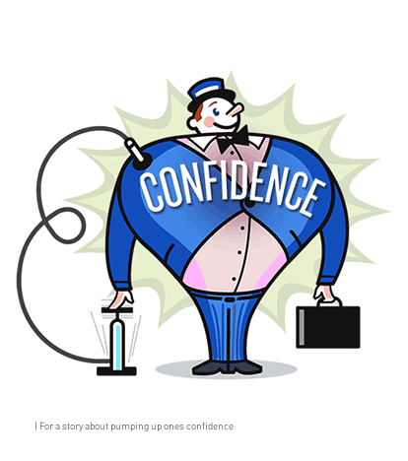
Personal dilemma why say yes to srs?
Relieves gender dysphoria
Increased mental stability
Boosts confidence
Increased sexual satisfaction
Notes:
a term used to describe transsexuals' discomfort with their anatomic sex,
Increased mental stability – some transsexuals experience suicide tendencies because of extreme dissatisfaction with original sex.

Slide 24
Personal dilemma why say no to srs?
Permanence
Surgical complications
Regret - face risk of losing family, job, friends
Notes:
Unsightly scarring, vaginas too small or short, breasts are not of desired size.
Come out of the closet into an ev’en bigger closet.
At risk of living in a transgender sub culture instead of part of real world.
Lose job – work as she male prostitute
They have no life expect for the past in their own biological sex – keep talking angrily about the past, “what I was”
No hope for future.

Slide 25
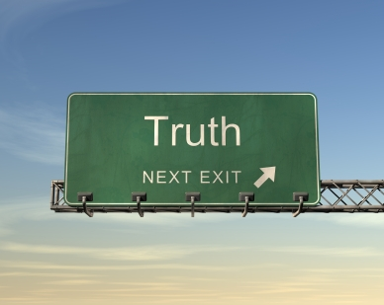
Virtue Approach
“Undergoing the sex change operation will allow one to be honest to himself and to his community. However, the honesty bears a heavy price tag”.
Notes:
Don’t they say that honesty is the best policy? So why should I not be true to myself and undergo the operation and make my true sexual orientation public instead of trying to keep it secret?

Slide 26
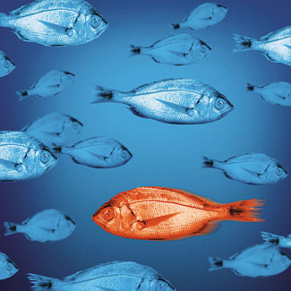
Utilitarian Approach
“Suppress your true orientation so as to be accepted by the community at large”.
Notes:
To please the majority of people, I should suppress my true sexual orientation in order to please the society.

Slide 27
Common Good Approach
“The world must compromise and learn to accept people for who they really are; rather than who society wants them to be”.
Notes:
For the good of every single person, The world must learn not to discriminate and accept oddity instead of imposing their own beliefs on others.

Slide 28
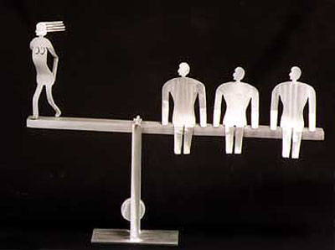
Fairness Approach
“It is not fair to impose your own personal views on another person. That will be tantamount to communism”.
Notes:
It is unfair to impose what you think is right on another person.

Slide 29
Rights Approach
“People have the right to decide for themselves”.
Notes:
Every human has rights. And they should decide for themselves what is best for them.

Slide 30
Conclusion
Transsexuality accepted

Slide 31
Conclusion
Transsexuality
Not accepted

Slide 33
What are your opinions of transsexuals?

Slide 34
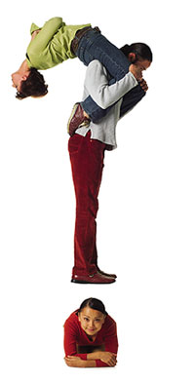
Specially For mr keith wong
After 10 years of dating, you find out that your girlfriend is a transsexual. What would you do?

Slide 35
If you realized that you have a different sexual orientation, would you opt for SRS?

Slide 36
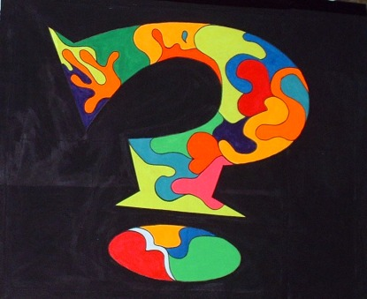
If your good friend came to you seeking advice about undergoing SRS, what would you say?

Slide 37
Thank you
“Any life is made up of a single moment, the moment in which a man finds out, once and for all, who he is”. - Jorge Luis Borges -

Slide 38
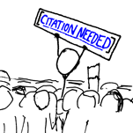
http://www.sciencedirect.com/science?_ob=ArticleURL&_udi=B6T8V-3W788PC-2&_user=2038769&_rdoc=1&_fmt=&_orig=search&_sort=d&_docanchor=&view=c&_searchStrId=1108959869&_rerunOrigin=scholar.google&_acct=C000055903&_version=1&_urlVersion=0&_userid=2038769&md5=b6f0ecf6e0a6975075d28de376b0749b
http://jenellerose.com/htmlpostings/transsexual_surgery_its_pros_and_cons.htm
http://medical-dictionary.thefreedictionary.com/transexual
http://www.who.int/gender/whatisgender/en/index.html
http://www.med.monash.edu.au/gendermed/sexandgender.html
http://www.prisontalk.com/forums/showthread.php?t=25974
http://juliaserano.livejournal.com/6195.html?thread=20787
http://www.gires.org.uk/Text_Assets/ATypical_Gender_Development.pdf
http://news.bbc.co.uk/2/hi/7689007.stm

