Slide 1
Cross Hormone Therapy for Transgender Patients
Member:
Steven M. Brown, MD
Transgender Medicine
Glendale, Wisconsin
April 3, 2014
stevethediseaseslayer@yahoo.com
A presentation for the:
4th Annual Transgender Medical Symposium
Fort Lauderdale, Florida

Slide 2
What is a Hormone?
Organic compound, secreted by a gland, in minute quantities, into the bloodstream, that has a regulatory effect on the metabolism of tissue or organs at a site different than the site of secretion
Alter the metabolism of cells or the synthesis and secretion of other substances (“tropic hormones”)
Bind to receptors (specific proteins) to “turn on” functions in target tissues

Slide 3
Endocrinology 101 Glands: Groups of cells which specialize in the secretion of hormones
Some important glands
Pituitary
Anterior pituitary
Growth hormone
Thyroid stimulating hormone
Adrenocorticotropic hormone (ACTH)
FSH
LH
Prolactin

Slide 4
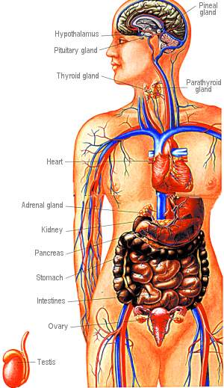
Additional Glands
Thyroid
Pancreas
Insulin
Hypothalamus
Parathyroid glands
Adrenal glands
Cortisol
Testosterone
Estrogen
Aldosterone

Slide 5
The “Sex Glands”
Ovaries
Progesterone
Estrogen
Regulate reproduction, bone metabolism, regulation of blood cholesterol, breasts, skin
Testes
Testosterone
Regulates reproduction, musculature, bone metabolism, cholesterol levels, red blood cell production

Slide 6
Chemical Origins of Sex Hormones
Derived from cholesterol
Chemical structures of estrogen, progesterone, testosterone vary slightly
Testosterone is a metabolite of progesterone
Estrogen is a metabolite of testosterone
Production is governed by negative feedback loops
Present in males and females in differing concentrations

Slide 7
Chemical origins of sex hormones

Slide 8
Changes Which Occur in Puberty
Pre-wired biological clock, probably in the hypothalamus, coincides with practical reproductive considerations
Hypothalamus releases Luteinizing Hormone-Releasing Hormone (LHRH).
LHRH passes down nerve endings, stimulates pituitary gland
In girls, around age 10 to 13, FSH and LH are produced—starts the cyclic activity of the ovaries in the production of estrogen
In boys, ages of 10 and 14 years, FSH and LH “switch on” testicular function in males (FSH triggers sperm production), LH triggers testosterone production

Slide 9
Why Use Cross-Hormone Therapy?
Change physical appearance to maximize consistency between physical identity and internal gender identity
Assist in being perceived by others as the patient’s perceived gender “passing”
For emotional well-being
Reduce bothersome erections in transwomen
Eliminate menstruation in transmen

Slide 10
WPATH, 2011, Hormone Therapy
Standards of Care:
“is a medically necessary intervention for many
transsexual, trans-gender, and gender nonconforming individuals with gender dysphoria”

Slide 11
Who Prescribes Hormone Replacement?
Primary care physician
Internist
Family Practitioner
“Gender dysphoria” clinic
Endocrinologist
Gynecologist
Urologist
Reconstructive surgeons
Psychiatrists

Slide 12
Health care provider issues in prescribing cross-hormone therapy
Lack of education
Lack of clinical experience
Relative paucity of studies
Unanswered questions
Personal discomfort
Religious, cultural prohibitions
Serious complications
Fear of litigation
Off-label administration of medications

Slide 13
Who SHOULDN’T Prescribe Hormones
Yourself
Family
Friends
Internet “buddies”
“Urgent care” physicians
“On-line” doctors
“On-line” pharmacies

Slide 14
Where Transgender Patients Get Hormones
“Black Market”, Internet
Medication may be impure
May be contaminated
Temptation to bypass
appropriate monitoring
Friends
Mexico
Local pharmacy
Reputable TG-friendly and experienced
on-line pharmacies

Slide 15
Transgender Greetings: Showing proper respect and helping those who are closeted
How would you like to be addressed in the office?
How would you like to be addressed over the telephone?
Under what name would you like prescriptions to be written?
How would you like to be addressed for phone messages left on an answering machine or voice mail?
◻ Do not leave phone messages
How should personal correspondence, lab reports, or appointment reminders
be addressed?
NAME ______________________________________
ADDRESS ______________________________________
◻ Do not send any personal correspondence
How should billing be addressed?
NAME ______________________________________
ADDRESS ______________________________________
E-MAIL ______________________________________
◻ Do not send any E-mail

Slide 16
Watch your pronouns!!

Slide 17
Expectations of your transgender patients seeking hormone therapy
Read your charts carefully BEFORE walking into a room.
Make sure you get the preferred name and pronoun early on in the history. The best way is to ask politely. THIS APPLIES TO THE WHOLE STAFF.
Let people know they are welcome in your office. And provide assurance that you will do your best to listen to their needs and provide care.
Also work into history how patients may wish to refer to their anatomy. Some would rather not hear the words "vagina" or "penis“

Slide 18
Expectations of your transgender patients
Patients feel that they should not have to educate health care providers on the medical problems that may occur due to taking hormones (for example the possibility of breakthrough bleeding after a transman has been on testosterone for a few years without a hysterectomy).
At the same time, most patients will appreciate your honesty if you don’t have an immediate answer to their questions, but can assure them that you will research the issue and/or confer with experts and follow-up in a very timely manner

Slide 19
Expectations of your transgender patients
When possible, alert other office staff that a patient may have a gender related issue.
For example, a patient may present as female but still have male anatomy. It can be very awkward when having a rectal exam and the attending nurses does not know the patient's history.
Have a general knowledge of the range of social issues that affect the transgender community and how this might impact the emotional and physical health of your patient.

Slide 20
Expectations of your transgender patients
Don’t assume sexuality
Options of contraceptives, testing, and reproductive care needs to happen no matter what the gender or sexuality

Slide 21
Expectations of your transgender patients
Everything does not revolve around transition or being a transgender patient. If a patient has a respiratory infection, they really just want to address that specific problem
“Unless the medicine that you are prescribing DIRECTLY affects my transition I want to get stuff for my cold and go back home to bed.”

Slide 22
Expectations of your transgender patients
As with every medical treatment, therapy needs to be tailored to the person's goals, the risk/benefit ratio of medications, the presence of other medical conditions, and consideration of social and economic issues.
There isn't just one path to transitioning medically. Some people want hormones and not surgery. Some want surgery but not hormones. Some want both, or neither. Some want low doses of hormones.
Some people seek maximum feminization/masculinization, while others experience relief with an androgynous presentation resulting from hormonal minimization of existing secondary sex characteristics
Hormone therapy can provide significant comfort to patients who do not wish to make a social gender role transition or undergo
surgery, or who are unable to do so

Slide 23
Friends and families of your patients will vary in their responses
For many, the initiation of hormones becomes the first opportunity to express their gender identity
Leads to problems with trust, confusion
Your patients will present at varied stages of “coming out”
Reactions by friends, family may include:
Shock
Denial
Negotiating
Anger
Acceptance

Slide 24
Counseling services
Transgender patients experience higher rates of marginalization, discrimination, harassment, family rejection, divorce, violence, isolation
Adjustment disorders:
Depression
Posttraumatic stress
Anxiety
Substance abuse
Suicidal ideation
Self-harm
Poor academic performance
Poor job performance

Slide 25
Counseling services—an interdisciplinary approach
Goal is to provide a nonjudgmental place for patients to explore their developing identities and address related challenges
Assist in determining the
appropriateness of cross-
hormone therapy

Slide 26
Recommended credentials for mental health professionals addressing gender dysphoria
Master’s degree or equivalent in an accredited clinical behavioral science field.
Competence in using the current DSM and/or the ICD for diagnostic purposes.
Ability to recognize and diagnose coexisting mental health concerns and to distinguish these from gender dysphoria.
Documented supervised training and competence in psychotherapy or counseling.
Knowledgeable about gender-nonconforming identities and expressions, and the assessment and treatment of gender dysphoria.
Continuing education in the assessment and treatment of gender dysphoria.
Standards of Care for the Health of Transsexual,
Transgender, and Gender-Nonconforming People, Version 7,
International Journal of Transgenderism, 13:165–232, 2011

Slide 27
Assessing gender dysphoria
History and development of gender dysphoric feelings
Impact of stigma attached to gender nonconformity on mental health
Support from family, friends, and peers (for example, in-person or online contact with other transsexual, transgender, or gender-nonconforming individuals or groups).
Identification of psychosocial pressures
The evaluation may result in no diagnosis; a formal diagnosis related to gender dysphoria, and/or other diagnoses
The role of mental health professionals includes making reasonably sure that the gender dysphoria is not secondary to, or better accounted for, by other diagnoses.
Standards of Care for the Health of Transsexual,
Transgender, and Gender-Nonconforming People, Version 7,
International Journal of Transgenderism, 13:165–232, 2011

Slide 28
WPATH Standards of Care for Initiating Hormone Therapy
Eligibility Criteria:
Persistent, well-documented gender dysphoria;
Capacity to make a fully informed decision and to consent for treatment;
Age of majority in a given country
If significant medical or mental health concerns are present, they must be reasonably well-controlled.
Standards of Care for the Health of Transsexual,
Transgender, and Gender-Nonconforming People, Version 7,
International Journal of Transgenderism, 13:165–232, 2011

Slide 29
Role of mental health professional in preparedness for hormone therapy
Help clients who are considering hormone therapy to be psychologically prepared
client has made a fully informed decision
has clear and realistic expectations;
is ready to receive the service in line with the overall treatment plan;
has included family and community as appropriate
has been evaluated by a physician to rule out or address medical contraindications to hormone use
has considered the psychosocial implications
reproductive options are explored before initiating hormone therapy.
Standards of Care for the Health of Transsexual,
Transgender, and Gender-Nonconforming People, Version 7,
International Journal of Transgenderism, 13:165–232, 2011

Slide 30
Components of a referral letter
The client’s general identifying characteristics;
Results of the client’s psychosocial assessment, including any diagnoses;
The duration of the referring health professional’s relationship with the client, including the type of evaluation and therapy or counseling to date;
Experience and/or training of the therapist in treating transgender patients
An explanation that the criteria for hormone therapy have been met and a brief description of the clinical rationale for supporting the client’s request for hormone therapy;
A statement that the patient is capable of making an informed consent ;
A statement that the referring health professional is available for coordination of care and welcomes a phone call to establish this.
Standards of Care for the Health of Transsexual,
Transgender, and Gender-Nonconforming People, Version 7,
International Journal of Transgenderism, 13:165–232, 2011

Slide 31
Responsibilities of Hormone-Prescribing Health Care Providers
Perform initial evaluation: discussion of physical transition goals, health history, physical examination, risk assessment, and relevant lab tests.
Discuss expected effects of feminizing/masculinizing medications and the possible adverse health effects, including reduction in fertility
Confirm the capacity to understand risks, benefits of treatment: capable of making an informed decision
Provide ongoing medical monitoring: regular physical and laboratory examination to monitor hormone effectiveness and side effects.
Communicate as needed with a patient’s primary care provider, mental health professional, and surgeon.
If needed, provide patients with a brief written statement indicating that they are under medical supervision and care that
includes feminizing/masculinizing hormone therapy.
Standards of Care for the Health of Transsexual,
Transgender, and Gender-Nonconforming People, Version 7,
International Journal of Transgenderism, 13:165–232, 2011

Slide 32
The first visit
Many have been waiting “all their life” to start cross hormone therapy
It’s a visit filled with anxiety, anticipation, fear that cross-hormones will be denied, and many, many questions
Most patients have read extensively via the Internet; it’s important not to assume that they are fully informed. It’s also important that you don’t talk “down” to them
A significant number will not have slept well the night before
The presence of a SOFFA is often helpful

Slide 33
The first visit
Useful material to bring along:
Letter from a therapist
Prior medical records
Insurance information (especially for ordering labs)
Patients, if they ask, may be encouraged to dress in any way that they feel comfortable
Block off about 90 to 120 minutes
Informed Consent
Cross-hormone therapy should be provided only to those who are legally able to provide informed consent.
Providers should document in the medical record that comprehensive information has been provided and understood about all relevant aspects of the hormone therapy, including both possible benefits and risks and
the impact on reproductive capacity.

Slide 34
Medical evaluation of transgender patients
History
Gender identity
Duration of dysphoria
Puberty
Cross-dressing activities
Prior evaluations, treatment
Psychotherapist
Letter from therapist
Real-life test (no longer a requirement, but it’s useful history)
Prior hormone therapy
Immunizations
Any concerns that they may be intersexed
Current medications
Past and current medical problems

Slide 35
Medical evaluation of transgender patients
Family history
Clotting disorders
Cardiovascular disease
Hypertension
Diabetes
Mental illness
Breast cancer
BRCA1 and BRCA2 gene mutations
Colon cancer
Prostate cancer

Slide 36
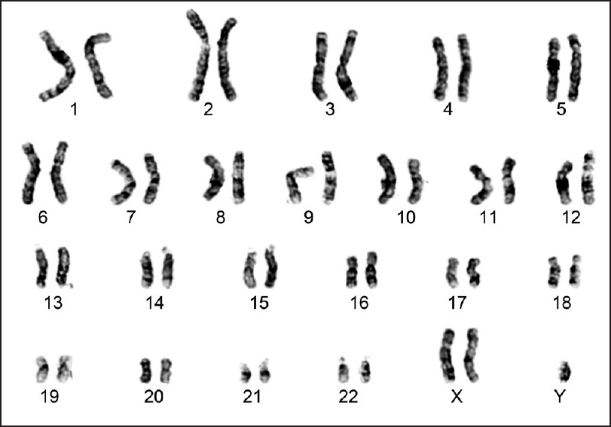
Medical evaluation of transgender patients
Prior chromosome testing (optional, sometimes desired)
Sexual orientation
Sexually active
Sexual function
Risk behaviors
Prior HIV testing
Occupation
Living situation
Social supports
Psychosocial pressures
Financial concerns

Slide 37
Medical evaluation of transgender patients
Obstacles to Compliance
Tobacco
Alcohol
Substance abuse
Discrimination, abuse
Financial stability
Homelessness
Past and current medical problems
Criminal history, uncontrolled anger
Past and current psychiatric problems, independent of gender dysphoria
Prior history of suicidal or violent ideation

Slide 38
Weighing Reproductive Options
To give opportunity to
obtain children who are
genetically “their own”
Sperm banking, egg harvesting, embryo banking
Gender reassignment and assisted reproduction, Human Reproduction 16: 612-614 (2001)

Slide 39
Actions of feminizing hormones
Induce the development of female secondary sexual characteristics
Anti-androgen treatment to reduce the effect of endogenous male sex hormones
Process can take many months/years

Slide 40
Feminizing hormones DO NOT
Cause the voice to increase in pitch.
Dramatically reduce facial hair growth in most people. There are some exceptions with people who have the proper genetic predisposition and/or are less than a decade past puberty.
Change the shape or size of bone structure, including skull shape, facial features, size of hands, nose, feet, teeth, jaw. However, they may decrease the bone density slightly.
Reduce waist size unless accompanied by dieting.

Slide 41
Effects of feminizing hormones on transwomen
Effects vary from patient to patient—familial, genetic tendencies
Younger patients generally obtain better and more rapid results
Noticeable changes usually within 2-3 months
Irreversible effects within 6 months
Feminization continues at a decreasing rate for two years or more, often with a “spurt” of breast growth and other changes after orchiectomy

Slide 42
Effects and expected time course of feminizing hormones
Effect | Expected Onset | Expected Maximum Effect
Body fat redistribution | 3–6 months | 2–5 years
Decreased muscle mass/strength | 3–6 months | 1–2 years
Softening of skin/decreased oiliness | 3–6 months | Unknown
Decreased libido | 1–3 months | 1–2 years
Decreased spontaneous erections | 1–3 months | 3–6 months
Male sexual function | Variable | Variable
Breast growth | 3-6 months | 2-3 years
Decreased testicular volume | 3–6 months | 2–3 years
Decreased sperm production | Variable | Variable
Thinning, slowed growth of body and facial hair | 6-12 months | Greater than 3 years
Male pattern baldness | No regrowth, loss stops 1–3 months | 1–2 years

Slide 43
Tanner Stage | Description (as applies to transsexual woman) | Example
Stage I (Pre-hormone treatment) | The undeveloped "pre-adolescent" pre-hormone type breast consists of a small elevated nipple (papilla) only, with no significant underlying breast tissue.
Stage II (Hormone treatment started) | After 6-8 weeks of hormone treatment subareolar nodules can be (painfully) felt and the nipple becomes very sensitive. After about three months breast buds will visibly start to form. There is an elevation of the breast and nipple as a small mound and the areola diameter may begin to enlarge (particularly in young women). Milk ducts inside the breast begin to grow.
Stage III | This stage is reached after between six months and a year of continuous treatment. There is further enlargement and elevation of the breast and areola (with no separation of their contours). The areola may begin to darken in color. The milk ducts give rise to milk glands that also begin to grow.

Slide 44
Tanner Stage | Description (as applies to transsexual woman) | Example
Stage IV | It will take one to two years to reach this stage. There is projection of the areola and papilla to form a secondary "mound on a mound" above level of breast.
Stage V | Only a very few transsexual women (usually under age 20) reach this "mature" stage, after perhaps two years hormone treatment. The breast has now fully filled out and only the nipple still projects, the areola has recessed and become part of the general breast contour i.e. the secondary mound has disappeared.

Slide 45
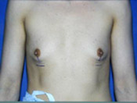
Effects of feminizing hormones on transwomen
Breast development
can take years, begins after 2-3 months
final size about 1 to 2 cup sizes less than close female relatives
less satisfactory results in older patients
Only one-third more than a “B”-cup
45% don’t advance beyond an “A”
growth not always symmetric
larger male thorax “dilutes” effect
enhanced by progesterone
nipples expand
areolae darken
clevelandplasticsurgery.com

Slide 46
Undesirable breast development
Hypoplastic breasts, more common after age 25. Very small or narrow, lack normal fullness, may seem bulbous or swollen at the tip due to over-prominent nipple-areolar complex - "tubular breasts", “Snoopy breasts". Shape usually caused by a failure to sufficiently develop the glands and lobules which help fill out the breast.

Slide 47
Effects of feminizing hormones on transwomen
Reduced or absent ability to ejaculate/maintain erection (variable), usually within 3 months
The prostate shrinks but does not disappear and prostate cancer is still possible (although risk is reduced)
Decreased penis size, scrotal size
Fertility and “male sex drive” drop rapidly—this may become permanent after a few months
Possible increased female-type sex drive/attraction to men

Slide 48
Effects of feminizing hormones on transwomen
Decreased facial/body hair
Body hair lightens in texture and color, frequently disappears
Cessation of male pattern baldness
Limited regrowth of scalp hair which has been lost
Improvement in thickness and texture of scalp hair
Enhanced action of 2% or 5% minoxidil (Rogaine®)
Not much effect on distribution of facial hair
Enhanced effect of electrolysis, laser hair removal
Decreased rate of growth

Slide 49
Cutaneous effects of feminizing hormones on transwomen
Redistribution of body and facial fat
Face looks more “feminine”—reduced angularity, fuller cheeks, facial feminization surgery not always needed
Redistribution of fat from waist to hips and buttocks
Skin softer/smoother/thinner, more translucent, less greasy
Skin sometimes becomes excessively dry
Improvement in spots and acne
Redistribution of fat to hips and buttocks
Brittle fingernails (lack of sebaceous oil)
Increased susceptibility to scratching and bruising
Oil and sweat glands become less active, resulting in dryer skin, scalp, and hair

Slide 50
Effects of feminizing hormones on transwomen
Sensory changes
Heightened sense of touch
Increased sense of smell and color
Emotional changes
More labile
Increased sensitivity to opinions of others
Decreased aggression

Slide 51
Effects of cross-hormone therapy on metabolism in transwomen
Metabolism decreases
Given a caloric intake and exercise regimen consistent with pre-hormonal treatment
Weight gain
Decreased energy
Increased need for sleep
Cold intolerance

Slide 52
Effects of feminizing hormones on transwomen
Loss of muscle mass
Leg cramps
Loss of strength (about 30%)
Estrogen prevents bone loss after testosterone deprivation
Decrease in blood concentration may reduce endurance
Diminished ability to perform heavy labor—may influence employment
Long-term follow-up of bone mineral density and bone metabolism in transsexuals treated with cross-sex hormones, Clinical Endocrinology, 48: 347-354

Slide 53
Other effects of Feminizing Hormones
Reduced risk of Alzheimer’s
Improved memory

Slide 54
Risks of feminizing hormones — some general principles
Complete risks in transsexuals is not known
Most studies are performed in biological women
Most studies involve “synthetic hormones”
Limited research regarding risks
Safety data and Food and Drug Administration approval do not acknowledge the use of hormones in transsexuals
All administration is thus “off-label”
Mortality not necessarily increased

Slide 55
Risks of feminizing hormones —
Risk Level | Disease process
Likely increased risk | Venous thromboembolic disease Gallstones Elevated liver enzymes Weight gain Hypertriglyceridemia
Likely increased risk with presence of additional risk factors | Cardiovascular disease
Possible increased risk | Hypertension Hyperprolactinemia or prolactinoma
Possible increased risk with presence of additional risk factors | Type 2 diabetes
No increased risk or inconclusive | Breast cancer

Slide 56
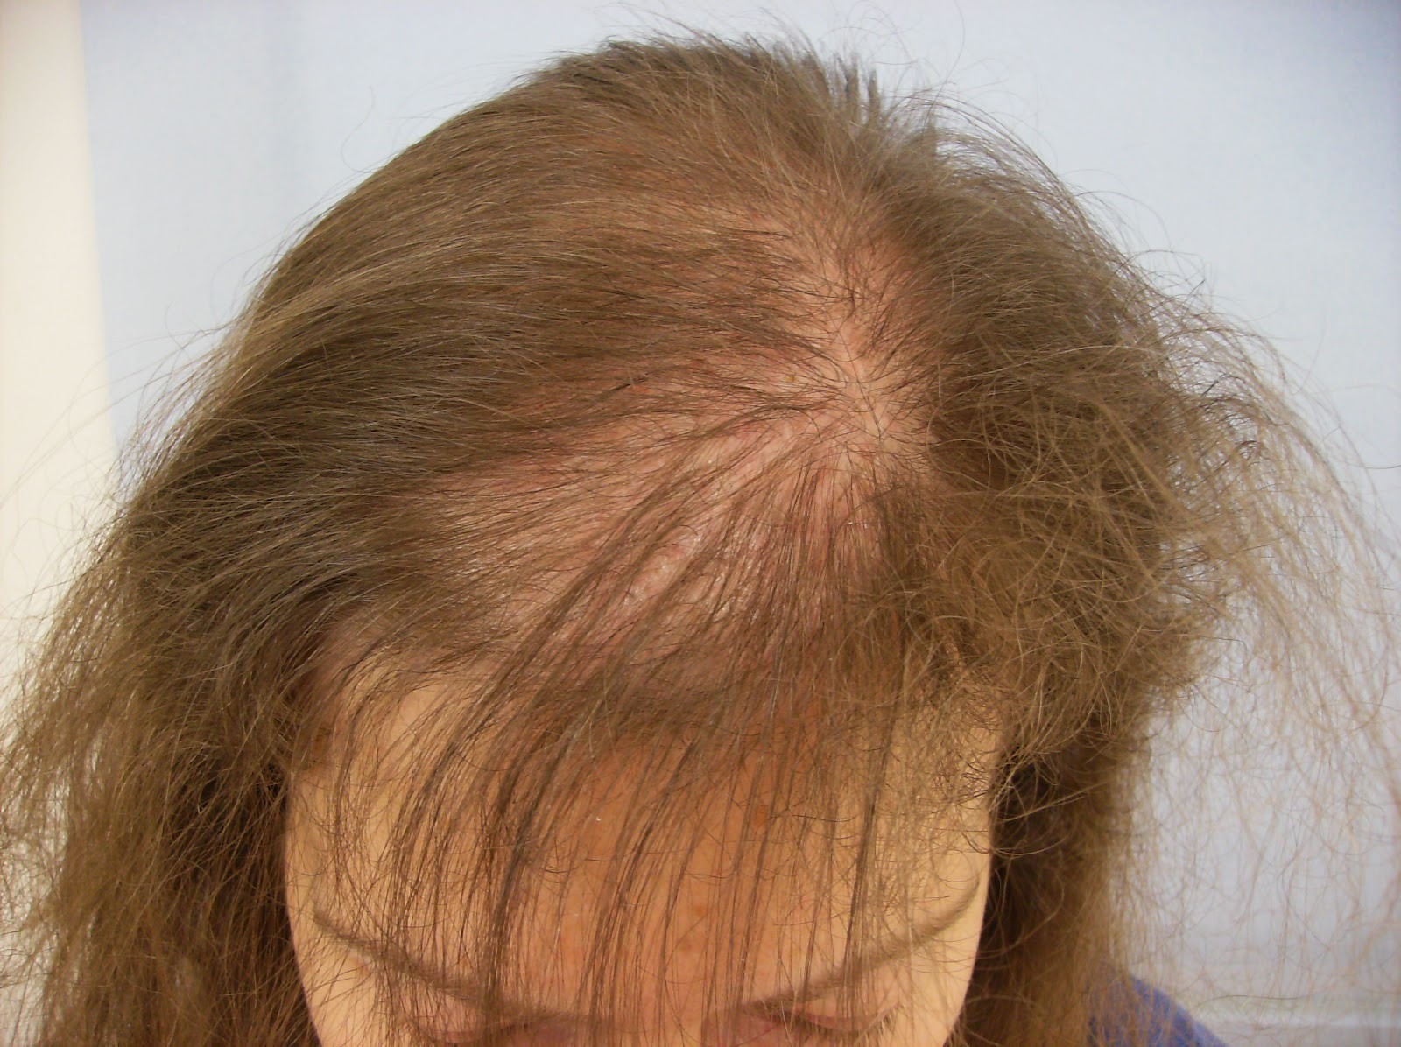
Other undesirable effects of feminizing hormones
Fluid retention
Excessive breast tenderness
Hair loss (telogen effluvium)
Fall in red blood cell count (anemia)
Hypertension
May vary with hormone regimen
Mortality and morbidity in transsexual subjects treated with cross-sex hormones, Clinical Endocrinology, 47: 37-342 (1997)

Slide 57
The cardiac risks of feminizing hormones
Most studies have and are being done in biologic women
Much evidence suggests that estrogen lowers cholesterol levels, and raises HDL (good cholesterol)
Increases triglycerides, blood pressure, subcutaneous and visceral fat
Decreased LDL particle size (bad)
Decreased insulin sensitivity (bad)
Increases blood pressure through fluid and salt retention

Slide 58
Reducing the odds of cardiac complications
If there’s a history or strong family history of heart attack, coronary artery disease, or stroke
Close supervision by a cardiologist, stress test
Blood pressure, lipid control, blood thinners
Estradiol (Estrace® 1 or 2 mg), a naturally occurring estrogen, is preferred to Premarin®
Usual dose is 4 mg daily pre-op, 2 mg daily post-op
Natural progesterone (Prometrium®) does not have the adverse effects of medroxyprogesterone (Provera®) on blood cholesterol or blood pressure levels
Consider daily administration of aspirin 81 mg daily
Reduce risk factors
No smoking
Watch weight
Watch blood sugar

Slide 59
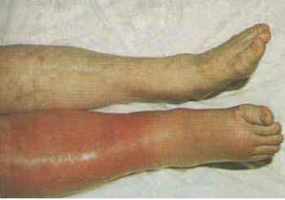
Risks of Feminizing Hormones
Blood clots—
12% over age 40
Usually start in the veins of the legs
Can break off and block blood supply to the lungs—a FATAL complication (pulmonary embolism)
20-fold increased risk in MTF’s
Risk increased with oral vs. transdermal estrogens
Central retinal vein occlusion has been reported
Mortality and morbidity in transsexual subjects treated with cross-sex hormones, Clinical Endocrinology, 47: 37-342 (1997)

Slide 60
Risk factors for Venous Thromboembolism
Surgery
Trauma (major or lower extremity)
Immobility, paresis
Malignancy
Cancer therapy (hormonal, chemotherapy, or radiotherapy)
Previous venous thromboembolism
Increasing age
Pregnancy and postpartum period
Estrogen therapies
Selective estrogen receptor modulators
Acute medical illness
Heart or respiratory failure
Inflammatory bowel disease
Nephrotic syndrome
Myeloproliferative disorders
Paroxysmal nocturnal hemoglobinuria
Obesity
Central venous catheterization
Inherited or acquired thrombophilia
Varicose veins
Smoking

Slide 61
Reducing the Risk of Blood Clots
Smoking cessation
Pharmacologic support
Relaxation therapy
Behavioral therapy
Discontinue estrogen for 3-6 weeks prior to any major surgery, including SRS
Review estrogen with surgeon and anesthesiologist prior to minor surgery
Discontinue estrogen in injuries which result in immobilization

Slide 62
Contraindications to cross-hormone therapy in transwomen
Absolute
History of thromboembolism or thrombotic tendency
History of macroprolactinoma
History of breast cancer
Active substance abuse
Relative
Coronary artery disease
Cerebrovascular disease
Hepatic dysfunction or tumor
Strong family history of breast cancer
Cholelithiasis
Poorly controlled hypertriglyceridemia
Poorly controlled diabetes mellitus
Refractory migraine headaches
Heavy tobacco use
Uncontrolled hypertension
Endocrine Therapy of Transsexualism and Potential Complications of Long-Term Treatment, Archives of Sexual Behavior, 27: 209-226 (1998)

Slide 63
Common anti-androgens
Spironolactone
Weak androgen receptor antagonist
Diuretic, associated with frequent urination
Can cause elevated potassium levels
Antihypertensive
100 to 400 mg daily
Associated with dry skin
Finesteride (Propecia®) (testosterone antagonist—decreases DHT)
5 mg daily
Reduces male pattern baldness

Slide 64
If on spironolactone, moderate ingestion of potassium rich foods

Slide 65
Androgen receptor antagonists
Flutamide (Eulexin)
Androgen receptor antagonist
Hepatotoxic
Reduced blood counts, including platelets
Hypertension
Fluid retention
Depression, anxiety, nervousness, lassitude, insomnia, GI disturbances
250 mg one to three times daily
Cyproterone acetate (Androcur®, Cyprostat®) (antigonadotropic)
Not available in United States
Androgen receptor antagonist
Nilutamide (Nilandron®) (androgen receptor blocker)

Slide 66
GnRH agonists
Act on pituitary
Overstimulating pituitary
Then desensitizing it to GnRH from hypothalamus
Used in adolescents to delay puberty or when hormones are withdrawn prior to surgery to reduce reversion to male
Limited experience
Drugs:
Nafarelin acetate (Synarel®) nasal spray
Goserelin acetate injection (Zoladex®)
Leuprolide (Lupron®)

Slide 67
Common estrogens
Estradiol valerate (Estrace®)
Equivalent to natural 17 β-estradiol
4-6 mg orally pre-op in divided doses
1-2 mg orally daily post-op
40 mg IM every two weeks, pre-op, 20 mg if age >60
Best combined with an antiandrogen

Slide 68
Common estrogens
Estraderm® patches—estradiol
Transdermal estrogen is recommended for those patients with risks factors for VTE.
50-100 µg/day transdermally

Slide 69
Progesterone therapy for transwomen
Use is controversial
Some clinicians believe that these agents are necessary for full breast development
Concerns regarding potential adverse effects: depression, weight gain, lipid changes, increased breast cancer risk and cardiovascular risk in women
Micronized progesterone may be better tolerated and have a more favorable impact on the lipid profile than medroxyprogesterone does
Cyproterone acetate is a progestational compound with anti-androgenic properties, not approved in the United States (concerns over potential hepatotoxicity), widely used elsewhere

Slide 70
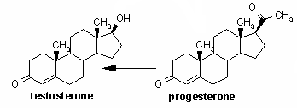
Medroxyprogesterone acetate Provera®
Good safety record
May be slightly virilizing—may be metabolized into testosterone
If virilization occurs, switch to micronized progesterone
Typical dose 5 mg twice daily pre-op for 10 to
30 days of the month
May enhance breast development
2.5 – 5 mg daily post-op

Slide 71
Natural progesterone
Micronized progesterone
Progesterone USP
Prometrium 100 to 200 mg daily
Molecular structure closer to the progesterone produced in a natal female's body
Provera has been linked to depression in trans women
Less androgenic
May carry less risks of heart disease and cancer
More costly
Not well studied, especially in trans-women

Slide 72
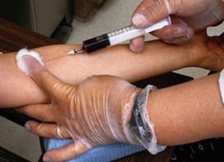
Laboratory testing and monitoring
Baseline
CBC, CMP, testosterone, lipid profile
6 weeks
CMP, testosterone, prolactin
24 weeks
CBC, CMP, testosterone, lipid profile, prolactin
48 weeks
CBC, CMP, testosterone,
(lipid profile, prolactin*)
*depending on clinical status

Slide 73
Estrogen levels
Levels may be misleading secondary to insensitivity of assays
Dosing is more commonly made on “clinical grounds”

Slide 74
Other Tests Which Can Be Followed
Calcium and phosphorus (skeletal health)
Bone densitometry every two or three years, especially post-orchiectomy
Mammography per routine recommendations

Slide 75
Monitoring physical examination
Mood and level of satisfaction
Vital signs, weight
Skin, development of acne
Hair, scalp, body hair
Breasts. Measure chest girth with cloth tape or paper tape measure (wipe down reusable cloth tape measure)
Gently squeeze nipples looking for discharge
Heart, lung exam
Examination of extremities for phlebitis, edema
Abdominal exam: liver span
Visual fields
Waist, hip measurements
No photo documentation

Slide 76
Important additional therapies
Aspirin 81 mg/day
Folic Acid 1mg/day
Vitamins (pre-natal) daily
Calcium 1200 mg daily

Slide 77
Effects of stopping feminizing hormones
Fatigue
Hot flashes
Depression
Mental confusion
Sleep disturbance
Vasomotor instability
Body hair loss, face hair and voice remain

Slide 78
Cross hormone therapy for transmen
Endocrinologic masculinization is achieved by the use of testosterone to induce male physical characteristics.
Testosterone works primarily by direct stimulation of receptors in target tissues; clinical effects correlate with elevation of serum testosterone level to a male reference range, rather than a decrease in serum estradiol
Testosterone also has antigonadotropic action in high doses.

Slide 79
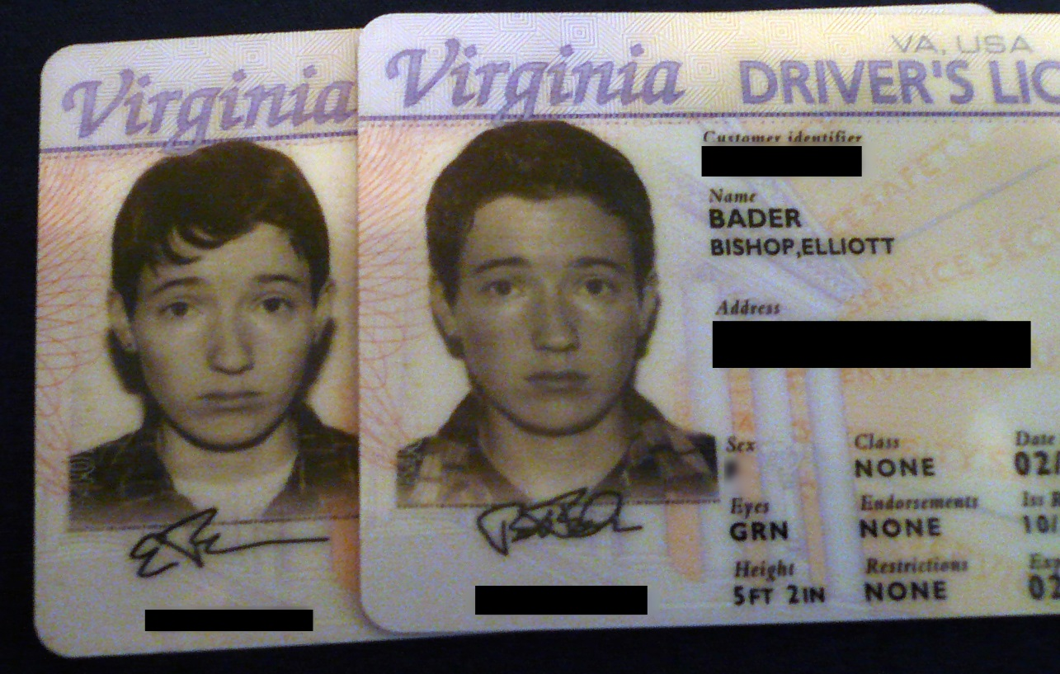
Cross hormone therapy for transmen
Biologic females respond quite well to hormone replacement as adolescents and as adults
Experience all the changes that genetic males experience during puberty
WARNING: Most of these changes are irreversible

Slide 80
Why is it easier for transmen?
In biologic females, addition of androgens excites androgen receptors which are there but dormant
Puberty occurs again, but differentiating as a male this time
In biologic males, bodies are already differentiated by the natural presence of androgen
Biologic males are thus more “resistant” to further pubertal changes

Slide 81
Contraindications to testosterone in transmen
ABSOLUTE
Pregnancy
Unstable coronary artery disease
Polycythemia with Hct greater than 55%
Coronary artery disease
Cerebrovascular disease
History of violent behavior or uncontrolled rage
Hepatic dysfunction or tumor
Strong family history of breast cancer
Cholelithiasis
Poorly controlled hypertriglyceridemia
Poorly controlled diabetes mellitus
RELATIVE CONTRAINDICATIONS
Refractory migraine headaches
Heavy tobacco use
Uncontrolled hypertension
History of uterine cancer
Severe obstructive sleep apnea
Androgen sensitive epilepsy
Bleeding disorders (for injected testosterone)
Endocrine Therapy of Transsexualism and Potential Complications of Long-Term Treatment, Archives of Sexual Behavior, 27: 209-226 (1998)

Slide 82
Effects of masculinizing hormones on transmen
Effect | Expected onset | Expected maximum effect
Skin oiliness/acne | 1–6 months | 1–2 years
Facial/body hair growth | 3–6 months | 3–5 years
Scalp hair loss | >12 months | Variable
Increased muscle mass/strength | 6–12 months | 2–5 years
Body fat redistribution | 3–6 months | 2–5 years
Cessation of menses | 2–6 months | n/a
Clitoral enlargement | 3–6 months | 1–2 years
Vaginal atrophy | 3–6 months | 1–2 years
Deepened voice | 3–12 months | 1–2 years

Slide 83
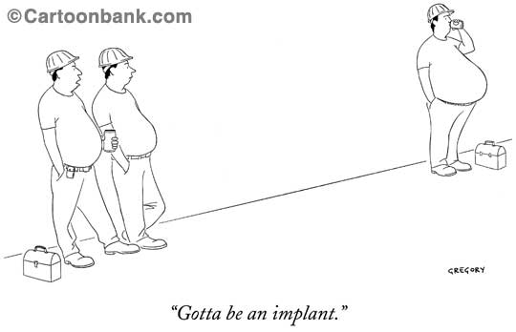

Slide 84
A warning about muscle changes
Tendon rupture occurs in both FTM patients on testosterone and genetic males taking anabolic steroids
FTMs who are involved in strength training should
increase weight load gradually
emphasize repetitions rather than weight.
Morgenthaler, M. & Weber, M. (2005). Pathological rupture of the distal biceps tendon after long-term androgen substitution. Zeitschrift für Orthopädie und Ihre Grenzgebiete, 137, 368-370.

Slide 85
Effects of masculinizing hormones on female reproductive organs
Enlarged clitoris (3-8 cm) with increased libido
starts after a few months
can become overly, painfully sensitive
peaks after 2-3 years
clitoral growth not enhanced by topical application of testosterone to the clitoris.
Atrophy of uterus, vagina and ovaries
Decreased vaginal secretions
More difficulty with penetration
Increased susceptibility to STD’s
Miller, N., Bedard, Y. C., Cooter, N. B., & Shaul, D. L. (1986). Histological changes in the genital tract in transsexual women following androgen therapy. Histopathology, 10, 661-669.

Slide 86
Testosterone and menses
Menses usually stop within 1-6 month
If menses persist after three months:
Increase the dose of testosterone to maximum recommended dose until:
serum free testosterone is within the upper quartile of the normal male range or menses stop

Slide 87
Important warning about fertility
Despite endometrial atrophy, cessation of menses, and reduced fertility there is evidence of ovulation even after several years of testosterone administration
Testosterone SHOULD NOT be relied upon as a failsafe contraceptive
Miller, N., Bedard, Y. C., Cooter, N. B., & Shaul, D. L. (1986). Histological changes in the genital tract in transsexual women following androgen therapy. Histopathology, 10, 661-669.

Slide 88
Trans-Men and pregnancy
No guarantee pregnancy will occur once hormones are started
Testosterone would need to be stopped
Ongoing counseling, extensive monitoring and treatment if this is a pathway which you wish to pursue

Slide 89
Other effects of testosterone
Growth spurt, closure of growth plates before puberty
Shoe size may increase
Increased bone density
Reduced risk of blood clots
Testosterone increases bone mineral density in female-to-male transsexuals: a case series of 15 subjects, Clinical Endocrinology, 61: 560-566
Venous Thrombosis and Changes of Hemostatic Variables during Cross-Sex Hormone Treatment in Transsexual People, J. Clin. Endocrin. Metab. 88: 5723-5729 (2003)

Slide 90
Effects of masculinizing hormones on transmen
Outer skin layer becomes rougher in feeling and appearance
Prominence of veins
The face becomes more typically “male” in shape.
Body odors (skin and urine) change. They become less "sweet" or "musky" and become more "tangy" or "metallic."
Emotions change: aggressive and dominant feelings may increase

Slide 91
A reminder: male hormones DO NOT
Significantly decrease the size of the breasts.
However, they may soften somewhat
Change the shape or size of bone structure
Grow a penis
Prevent pregnancy
Work overnight

Slide 92
Risks of masculinizing hormones
Risk Level | Disease process
Likely increased risk | Polycythemia Weight gain Acne Androgenic alopecia (balding) Sleep apnea
Likely increased risk with presence of additional risk factors
Possible increased risk | Elevated liver enzymes Hyperlipidemia
Possible increased risk with presence of additional risk factors | Destabilization of certain psychiatric disorders Cardiovascular disease Hypertension Type 2 diabetes
No increased risk or inconclusive | Loss of bone density Breast cancer Cervical cancer Ovarian cancer Uterine cancer

Slide 93
Risks of masculinizing hormones
Ovarian cancer—long-term exposure to endogenous and exogenous androgens are associated with ovarian epithelial cancer
Steroids increase epidermal growth factors and transforming growth factor (TGF-α) which promote cancer growth
Polycystic ovaries
Endometrial hyperplasia—risk of endometrial cancer
Breast cancer—breast cells may remain even after mastectomy
Ovarian Cancer in Female-to-Male Transsexuals: Report of Two Cases, Gynecologic Oncology 76: 413-415 (2000)

Slide 94
Risks of masculinizing hormones
Reduced HDL cholesterol (bad)
Reduced LDL particle size (bad)
Increases triglycerides
Polycythemia (elevated red blood cell levels)
Increased sweating
Increased metabolism
“Hot flashes”

Slide 95
Testosterone and the liver
Testosterone-induced hepatotoxicity
Increased liver enzyme levels are a frequent occurrence
occurs in about 15%
Hepatic adenomas
Hepatocellular carcinomas
Peliosis hepatitis—blood-filled cavities in the liver

Slide 96
Basic masculinizing regimen
 | Intramuscular injection |  | Transdermal gel | Transdermal patch
Agent | Testosterone cypionate | Testosterone enanthate | Testosterone crystals dissolved in gel
Brand name | Depo-Testosterone® | Delatestryl® | AndroGel® | Androderm®
Pre-oophorectomy | 25-40 mg every week (or 50-80 mg every two weeks); gradually increase each month until blood testosterone is within normal male range or there are visible changes (typically 50-100 mg every week, or 100-200 mg every 2 weeks) |  | 5-10 g daily; start with 2.5 grams if comorbid conditions could be worsened by testosterone | 5-10 mg patch applied daily; start w/ 2.5 mg patch if comor-bid conditions may be exacerbated
Maintenace after 2 years | Reduce to level needed to keep serum free testosterone within the lower-middle end of the male reference interval. Monitor risk of osteoporosis.

Slide 97
Androgen replacement warnings
Risk of inadvertent exposure to others who come into contact with skin gel or patch
Keep away from children
Excessive testosterone may lead to stroke and heart attack
Endocrine Therapy of Transsexualism and Potential Complications of Long-Term Treatment, Archives of Sexual Behavior, 27: 209-226 (1998)

Slide 98
Other androgen replacement
Testosterone pellets (Testopel)
6 -12 pellets under the skin every three months
Local anesthetic
More constant blood levels
Oral
Andriol—not available in the US
Has to pass through liver
Sublingual/buccal lozenge
Striant—absorbed through oral mucosa, avoiding liver
Gum irritation
Taste changes
Headaches

Slide 99
Drug Interactions of testosterone
Drugs which decrease levels of testosterone levels:
Phenobarbital and Dilantin (seizure medicines)
Rifampin
Alcohol!
Drugs which increase levels of testosterone:
Serzone, Prozac, Paxil (antidepressants)
Sporanox, Diflucan (antifungals)
Tagamet
Biaxin, Zithromax (antibiotics)
Protease Inhibitors (HIV treatment)
Testosterone can also alter the effects of other drugs:
Increase the blood thinning effect of Coumadin
Decreases the effectiveness of Inderal (propranolol) a blood-pressure medicine
Increases the effect of some oral medicines for diabetes and can cause dangerously low blood sugar levels

Slide 100
Progesterone treatment in FTM’s
Short-course progesterone therapy to
Induce menstrual period in first 2 years to shed build-up of endometrial lining (if a hysterectomy has not been performed)
Reduces spot bleeding
Decreases risk of uterine cancer

Slide 101
Laboratory testing and monitoring
Baseline
CBC, CMP, lipid profile, pregnancy test
45 days
Fasting CMP, testosterone
24 weeks and 3 days
CBC, fasting CMP, testosterone, lipid profile
48 weeks and 3 days
CBC, fasting CMP, testosterone, (lipid profile)
*depending on clinical status

Slide 102
Monitoring physical examination
Mood and level of satisfaction, history of anger
Vital signs, weight
Skin, development of acne
Hair, scalp, body hair
Heart, lung exam
Abdominal exam: liver span
Voice changes
Hard to quantify
Ask how they are perceived over the phone
No photo documentation

Slide 103
General advice for patients
NEVER use hormonal medication prescribed for another person
DON’T self-medicate
Don’t double dose
Don’t alter regimen
without supervision

Slide 104
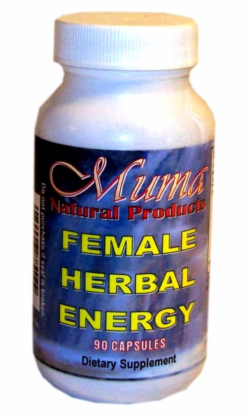
A word about herbals
Not benign—potential for liver injury
Still a medication and self-medicating
Unregulated by FDA

Slide 105
Some general advice for patients
There is a lot of misinformation, especially on the Internet
Hormone therapy remains somewhat “hit and miss”
“Individual results will vary”, especially for MTF, less so for FTM’s
Extremely important to let any treating physician and pharmacist know of all your medications to avoid “drug-drug” interactions and to reduce potential complications
Need to keep spouse/significant others informed

Slide 106
Developing realistic expectations

Slide 107
Some general advice for patients
Review risks and benefits before starting any hormones
Be sure that this is what
you really, really want…
permanent changes can occur
within weeks
Be patient
Eat healthy and exercise
Reduce alcohol
intake (reduce stress on liver)

Slide 108
Good advice for EVERYBODY
DON’T let your weight get out of control
DON’T smoke

Slide 109
General advice for patients
Have regular medical checkups and laboratory testing (every 2-3 months, at first)
Watch your blood pressure
Give the body time to adjust
Use the lowest hormone dosage that affords the desired changes

Slide 110
Some important consumerism
See a reputable doctor for your care
Be honest and up front with your doctor about all medications
Make a list of questions prior to each visit—don’t be afraid to ask questions
EDUCATE your doctor, especially if you disagree
Keep records of all changes—physical and emotional, and SHARE them with your doctors
BE PATIENT with medical staff
POLITELY correct if the wrong pronouns are used

Slide 111
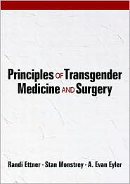
For more reading

Slide 112
“Treat people as if they were what they ought to be and you will help them become what they are capable of becoming”
Johann Wolfgang Von Goethe

Slide 113
Questions?
stevethediseaseslayer@yahoo.com

