Slide 1


Slide 2


Slide 3
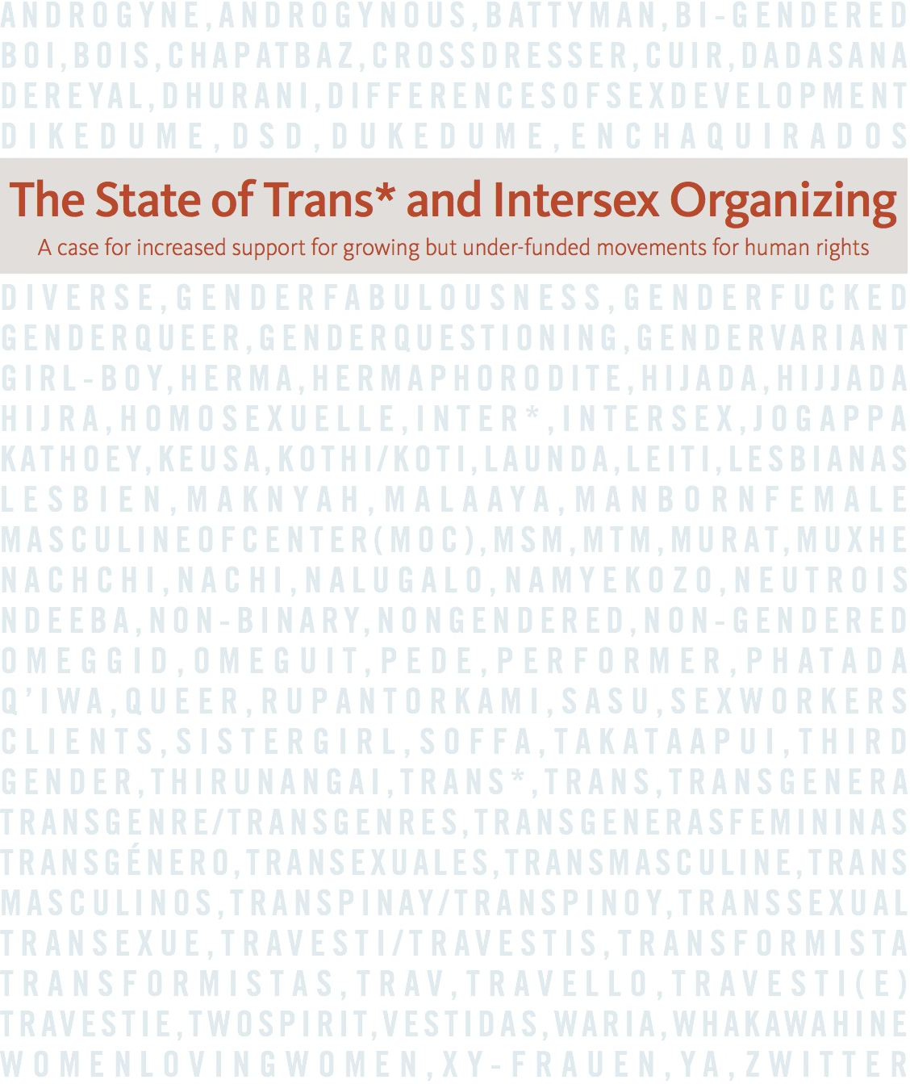

Notes:
Worked on this together with AJWS and Strength in Numbers
Final sample size is 340 groups.
Our report also includes stories of trans* and intersex groups to illustrate their work. We found several limitations, but definition of leadership was definitely the most important one.
Decided to add intersex groups because we felt it would otherwise have been a missed chance, and funding for intersex groups is even worse that for trans* groups.

Slide 4
Number of Responding Groups per World Region
Notes:
Wide distribution of survey among trans* and intersex groups throughout the world, which is reflected in regional responses. However there are large white spots on the map.
Most trans* and intersex groups work locally.
- Groups surveyed work primarily within their home countries. In the sample there are also 22 groups stating they work regionally (7%) and six stating they work globally (2%).

Slide 5
Leadership Demographics of Groups
Notes:
Self-led means groups whose important financial decisions are made entirely or mostly by intersex people and/or trans* people.
A quarter of the groups reported that their constituents are mostly or all people living with HIV (25%, n=313). A third described their constituencies as mostly or all sex workers (31%, n=303). half of the groups reported that their constituents are mostly or all from low-income backgrounds (51%, n=298).
Half of trans* and intersex groups are not independent organizations, constraining their ability to make important decisions about their work. Only a quarter (26%) of these groups make most or all of their own financial decisions. This means that a large number of trans* and intersex activists are not able to use their knowledge of their communities’ needs and priorities to make decisions about how the resources dedicated to them are spent.

Slide 6
Budget of Groups
2012 Budget (n=324) and 2013 Budget (n=338)
Notes:
More than half (54%) of groups have a current annual budget of less than $10,000. Nearly all groups (95%) have budgets of less than $250,000 a year (n=338).

Slide 7
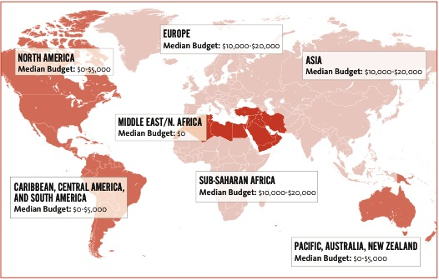
Median Budget Size per Region
Notes:
There are regional trends, with groups in Middle East / North Africa having the least amount of money available.

Slide 8
Groups with Full-Time Staff Members
(n=319)
Notes:
A much smaller proportion of trans*- and intersex- led groups (46%, n=198) have paid staff, compared to groups that are not self-led (84%, n=32). Clearly, trans* and intersex groups do not have sufficient staff capacity to carry out their critical work.

Slide 9
Budget, Savings and Staff by Leadership Demographic
Notes:
Intersex-led groups have a median annual budget of $0 - $ 5,000.
Trans*-led groups have a median annual budget of $5,000 - $10,000.
In sharp contrast, groups that are not led by trans* or intersex people have a median annual budget of $20,000 - $50,000 for their trans*/intersex work.
We also see differences in whether groups have reserves and whether groups have paid staff.

Slide 10
Work Areas
Notes:
Notice the absence of HIV from this list – but the presence of areas that heavily influence the spread of HIV.
For many trans* and intersex groups it is impossible to fully separate advocacy work from service provision. In the absence of other organizations available to meet pressing community needs, a group’s ability to support its members and constituents in accessing services can help create the baseline of stability needed to sustain the group’s advocacy. This applies to leaders of groups, as well. In order to build strong and effective movements, access to services—including psychosocial support—is crucial, given the systemic trauma, violence and exclusion from society that trans* and intersex people face.
Groups report that it is next to impossible to find funding for gender transition or other health-related costs, which is a high priority for their members. This is particularly crucial for grassroots groups working to build a base for sustainable activism. Groups struggle when members are vulnerable and frequently in crisis. Several groups mentioned how one member’s health crisis had a significant impact on the other members and on the organization’s work. Constituents or members who lack a baseline of stability in terms of basic health and livelihood will reap less benefit from programming and will be able to put less energy into advocacy activities. Funders should look for ways to support groups to meet these needs.

Slide 11
Non-Financial Support Desired Most (n=312)
Notes:
Groups want funding to network and exchange with other groups, including at conferences.
Groups want mentoring and they want skills training.

Slide 12
Skills Training Desired Most (n=311)
Notes:
Clear priorities for skills training – fundraising is #1

Slide 13
“I was shocked at how hard it is to raise funds for a trans* organization.”
“It’s very hard for us to identify funding organizations with criteria that we meet ... intersex isn’t on their list.”
“We’re just not on funders’ radar.”
“As we are “T” specific, it is difficult to access LGBT funding.”
Notes:
“I was shocked at how hard it is to raise funds for a trans* organization.”
“It’s very hard for us to identify funding organizations with criteria that we meet ... intersex isn’t on their list.”
“We’re just not on funders’ radar.”
“As we are “T” specific, it is difficult to access LGBT funding.”

Slide 14
Recommendations
Notes:
Fund intersex groups and trans* groups as distinct areas of work.
Include trans* and intersex work in every relevant area of your work.
Support groups that are led by trans* or intersex people.
Recognize the diversity of trans and intersex communities, respect local definitions.
Seek groups whose work is representative of the communities they serve.
Pay specific attention to groups working with trans* and intersex people who are marginalized in multiple ways.
Help groups hire from affected communities.
Provide general operating support and multi-year grants, and seek to streamline funding procedures.
Train foundation staff on trans* and intersex issues, and hire trans* and intersex experts.
Track your funding for trans* and intersex issues.

